Slide 1
Web design processes
Riyam k.Marjan
University Of Babylon – Faculty of Information Technology
Third Stage – 2019-2020

Slide 2

Web design processes
Design
Develop
Test
Maintain
Define

Slide 3
Definition process
Understanding site goals
business goals directly influence the site’s structure
e.g. “I want my site do…”
Gathering business requirements
e.g. “the site should have the ability to …”
keep it high level
make a list
e.g. the ability to register
e.g. the ability to log in/log out
Prioritize:
a must-have
nice-to-have/ could-have
Building a project plan
how much time/money/people to accomplish each step
gantt view
Microsoft project
the “look- n- feel” approach
the sketching approach

Slide 4
Web design processes
Design
Develop
Test
Maintain
Define

Slide 5
Design process
creating the sitemap
designing the wireframe for each page
Implementing user testing
Testing wireframes with users
Putting together a content plan
e.g. a content like a news area needs to know from where the news will come and how the client will be able to update it?
Establishing “look-n-feel”
explore different designs for the site
Getting input from a focus group

Slide 6
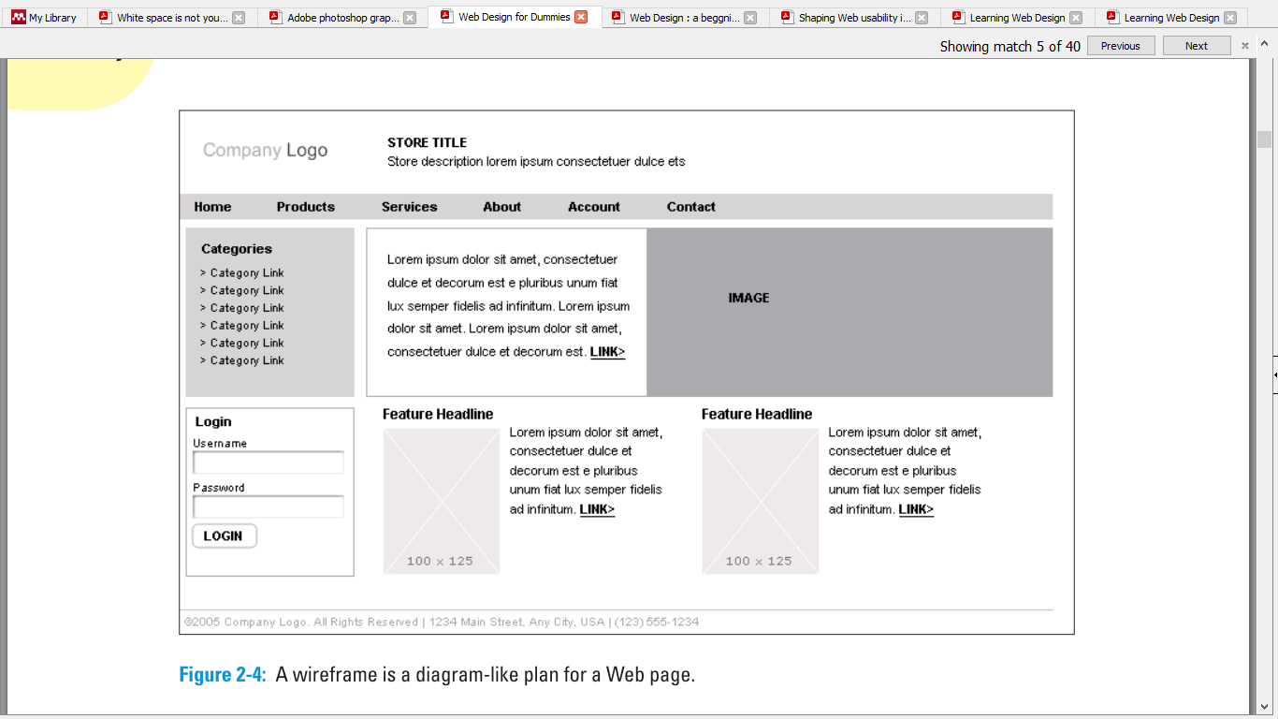
Design process
Wireframe

Slide 7
Design process
Wireframe benefits:
Global navigation scheme (the navigation that appears on each page of your site)
Text and media chunks and their relative placement ?
Interaction design (how people use the elements on the page)

Slide 8
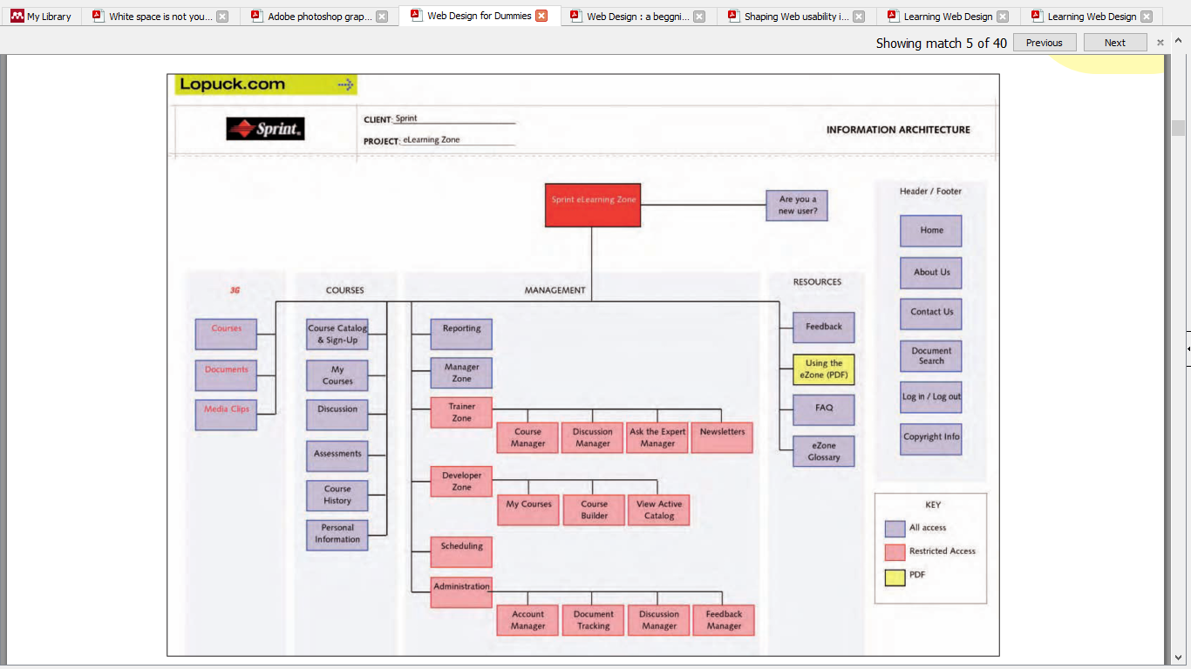
Design process
Site map

Slide 9
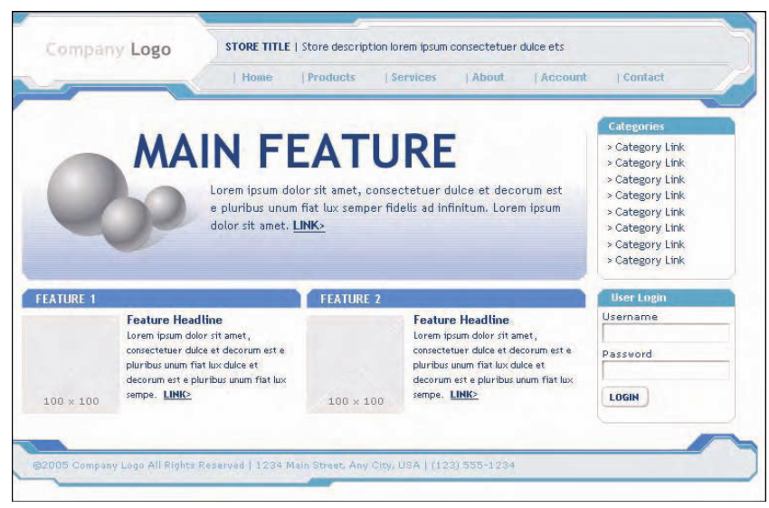
Design process
Design 1

Slide 10
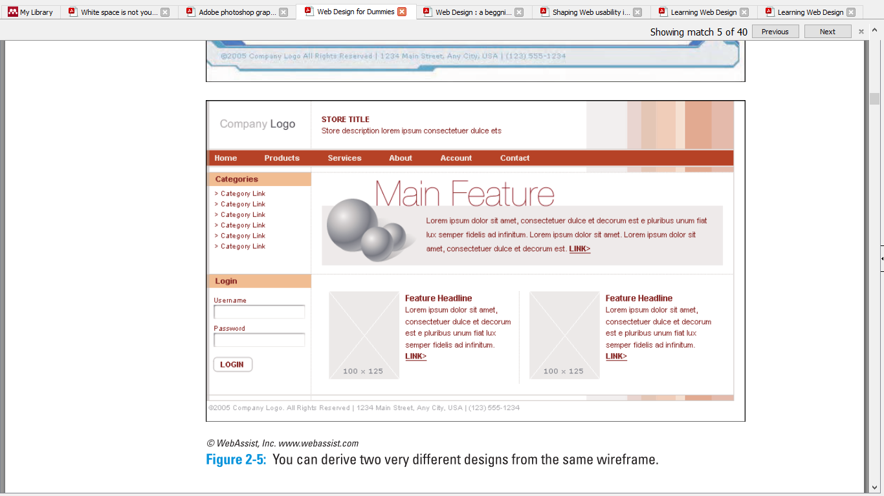
Design process
Design 2

Slide 11
Development process
Design
Develop
Test
Maintain
Define

Slide 12
Development process
Producing final web graphics
use Adobe Photoshop or Macromedia Fireworks for graphics
Content development
Media development
Flash development
save formats in web-friendly format
prepare video, audio, Flash animation, and graphics
Holding it all together with HTML
Databases, programming, and things to make your head spin
Producing final web graphics
Microsoft’s Active Server Pages (ASP)
ASP code connects to an online database
Type ASP code or use dreamweaver

Slide 13
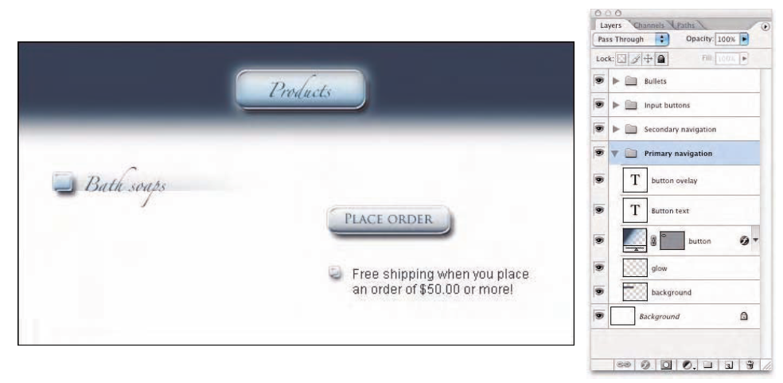
Development process
One Photoshop file can have the layers needed to create and export all the buttons needed for a Web site

Slide 14
Test process
Design
Develop
Test
Maintain
Define

Slide 15
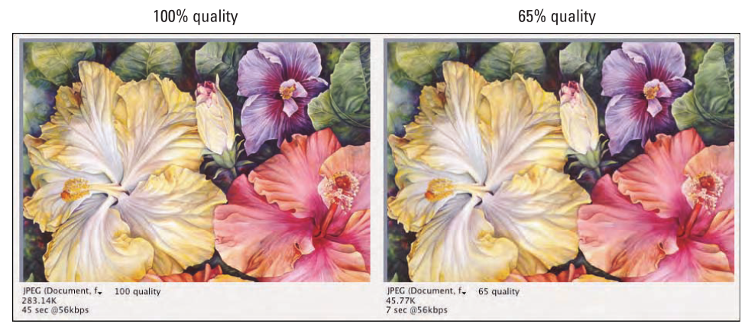
Test process
Producing final web graphics
Quality assurance
checking for misspellings
different browsers
image quality
Site lunch
Site on its web server
watch a site closely for the first couple weeks

Slide 16
Usability & Aesthetic
Is your design is good or bad?
It depends on two main standpoints:
Usability standpoint (usable website)
functionality
effective presentation of information
efficiency
Aesthetic standpoint (beautiful website)
presentation
hot animations
nice graphics

Slide 17
Usability & Aesthetic
There are tools usually give direct recommendations on how to improve the following features of a website:
Navigation and design
Page speed
Responsiveness
Accessibility
Text readability

Slide 18
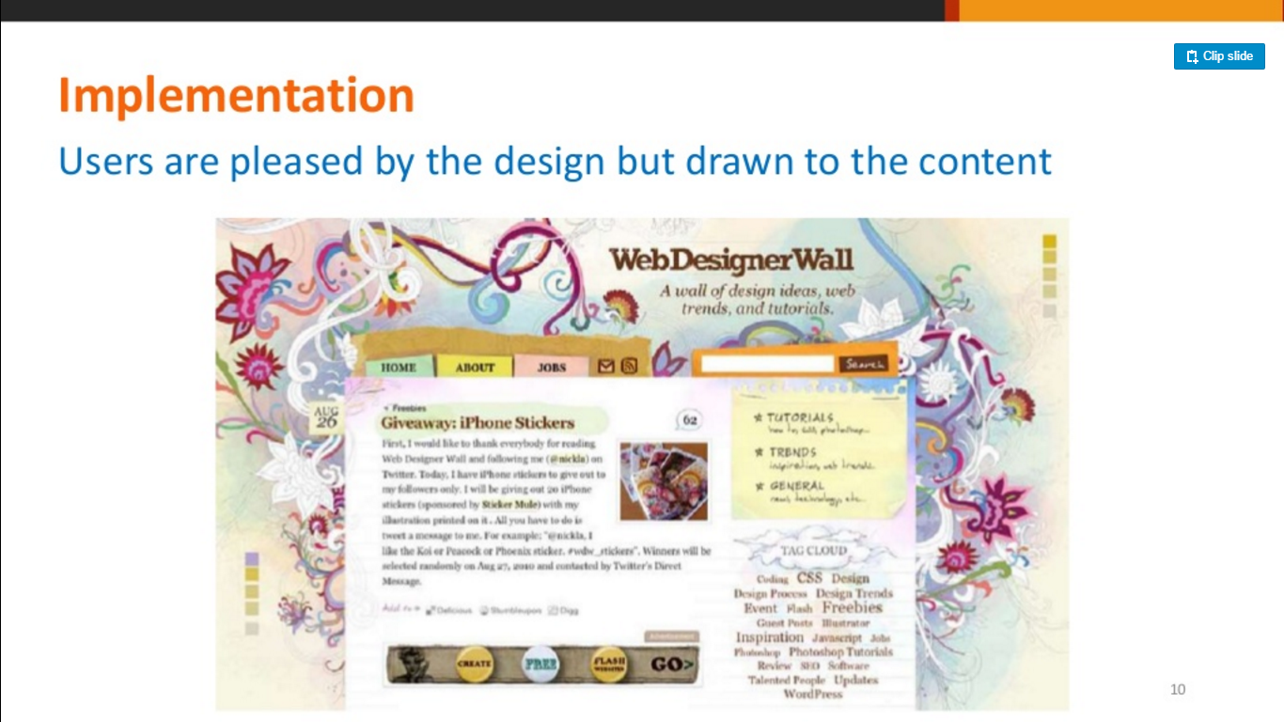
Design: Beauty & usability balance
Example:
the colourful graphics grow around the blocks of content, leading the eye back to the information without interfering with the pages’ readability or organization

Slide 19
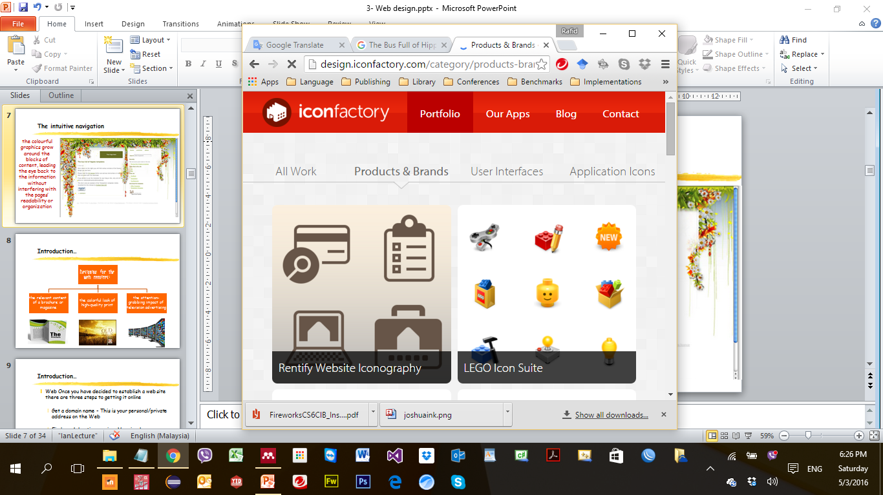
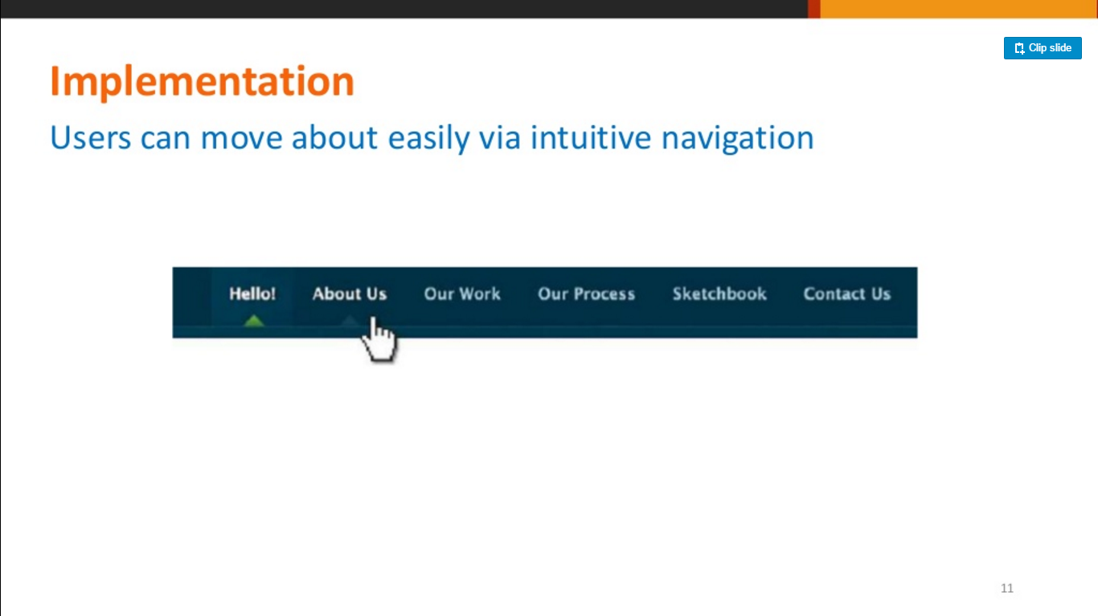
Design: Intuitive navigation
Example:
secondary navigation, search fields, and outgoing links should not be dominant features of the page. This allows user to focus on the information and content

Slide 20
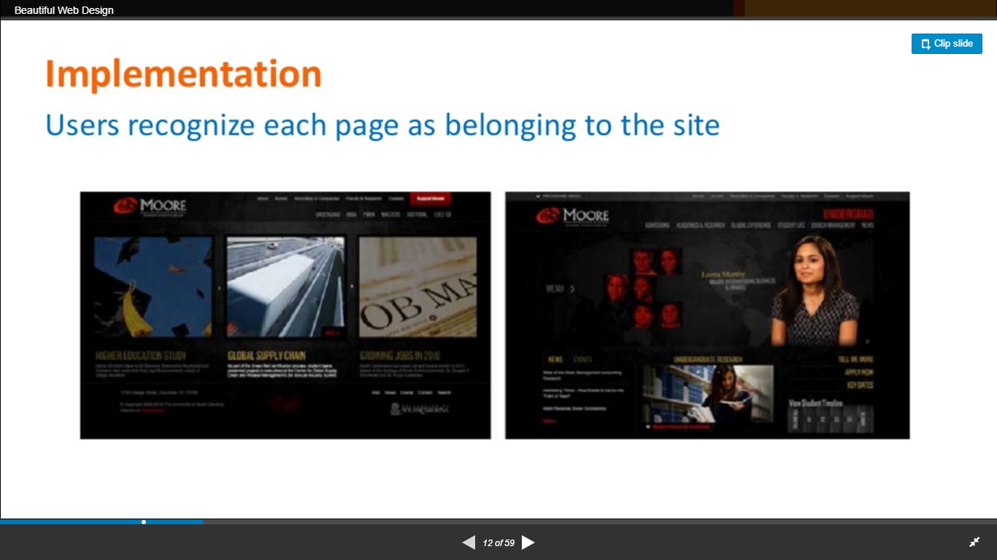
Design: Cohesive theme
Example:
users recognize each page as belonging to the site

Slide 21
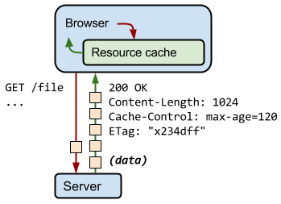
Page speed: Leverage browser caching
Setting an expiry date or a maximum age in the HTTP headers for static resources instructs the browser to load previously downloaded resources from local disk rather than over the network.
Notes:
2121

Slide 22
Page speed: Leverage browser caching
Fetching something over the network is both slow and expensive. Each server response provides the correct HTTP header directives to instruct the browser on when and for how long the browser can cache the response.
Notes:
2222

Slide 23
Page speed: Optimize images
Properly formatting and compressing images can save many bytes of data. If you can eliminate an image resource, which often requires a large number of bytes relative to HTML, CSS, JavaScript and other assets on the page, then that is always the best optimization strategy. There are three universally supported image formats: GIF, PNG, and JPEG. Some browsers also support newer formats such as WebP and JPEG XR.
Notes:
2323

Slide 24
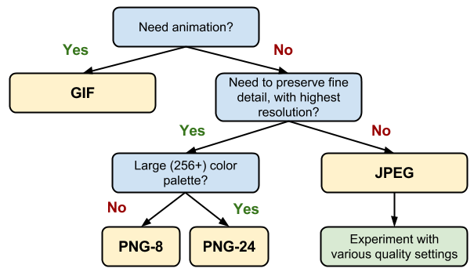
Page speed: Optimize images
so, which format should you use?
Notes:
2424

Slide 25
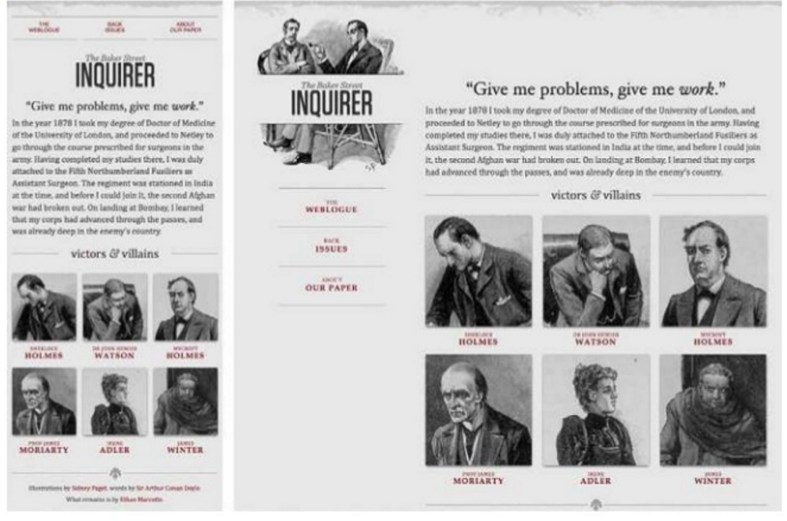
Mobile: Responsiveness
How your website looks on various desktop screens and mobile devices.

Slide 26
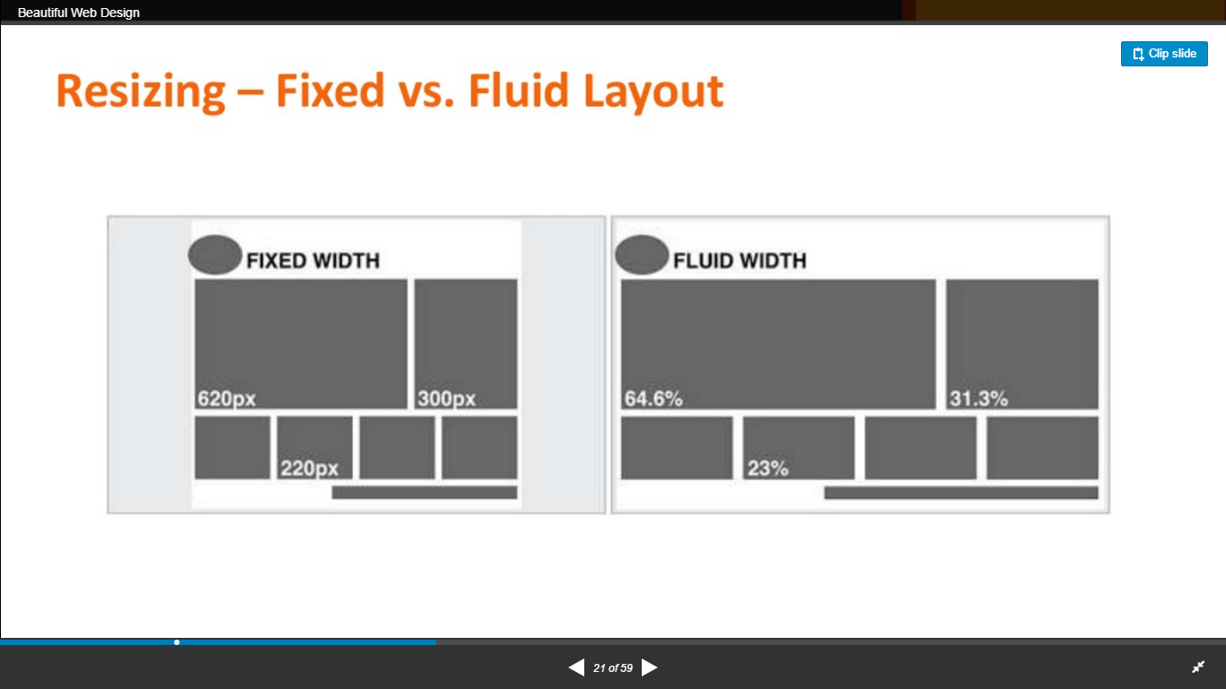
Mobile: Responsiveness

Slide 27
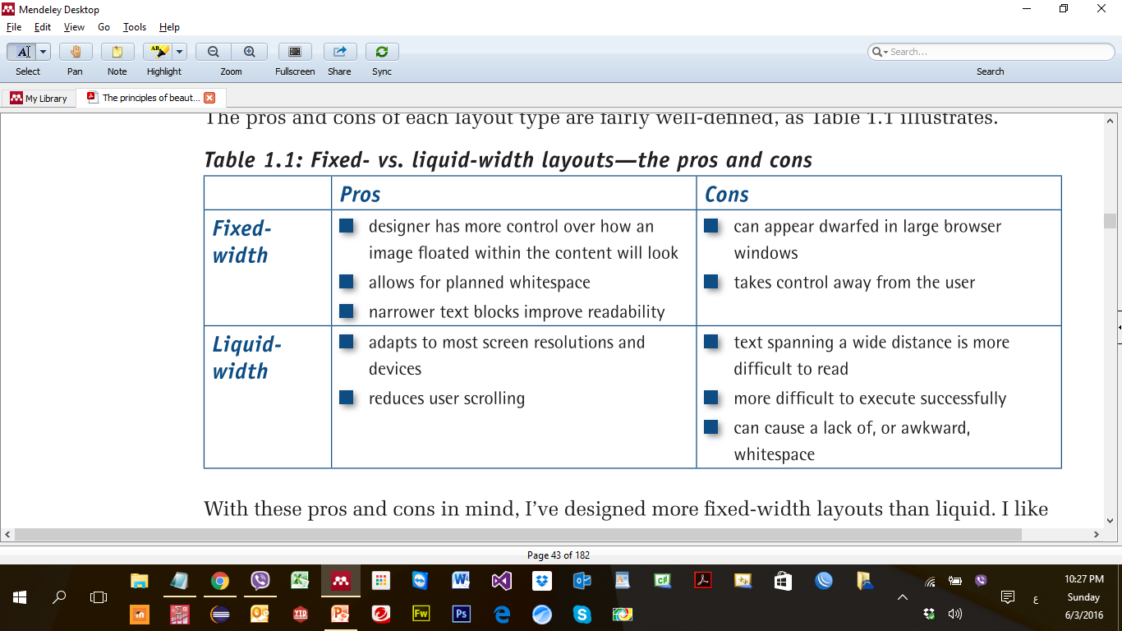
Mobile: Responsiveness

Slide 28
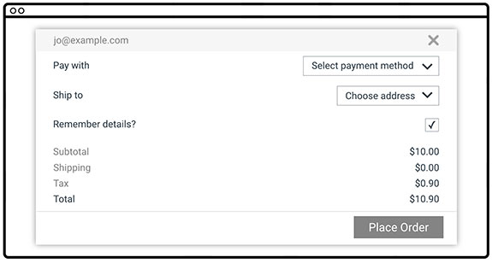
Accessibility
when we say a site is accessible, we mean that the site's content is available, and its functionality can be operated, by literally anyone.
e.g. an accessibility issues:
text is low contrast
Having labels on the left and fields on the right
The "Remember details?" label isn't associated with the checkbox
Notes:
2828

Slide 29
Readability: Reading Level Algorithms
Readability is the measure of how easy it is to read and comprehend a document. Readability tests were first developed in the 1920s in the United States. They are mathematical formulas, designed to determine the suitability of books for American students at a certain age, or grade level.
Reading level algorithms:
Gunning Fog
Flesch Reading Ease
Flesch-Kincaid
Notes:
2929

Slide 30
Maintain process
Design
Develop
Test
Maintain
Define

Slide 31
Maintain process
Site on its web server
watch a site closely for the first couple weeks
Examples of tools for testing and maintenance:
Usabilla
Loop11
TryMyUI
Google Pagespeed Insights
Pingdom Website Speed Test
Juicy Studio Readability Test
Check My Colors
Chalkmark
Optimizely
ClickHeat
Responsive Design Testing Tool

Slide 32
Understanding team member roles
Business specialists
setting the goals for the site
reeling in the visitors
Visual designers
craft the site’s structure
craft the the navigation
user interface design
the appearance of the site
integrate text, graphics, and animation
Information architects
design a site map diagram
creates a series of wireframe diagrams
Content designers
content Strategist
copy writer
Media specialists
media design
Interactive design
HTML slingers
assemble Web pages in HTML
Maintain browsers’ compatibility
Programmers
build template Web pages
database and Web page dynamics

Slide 33
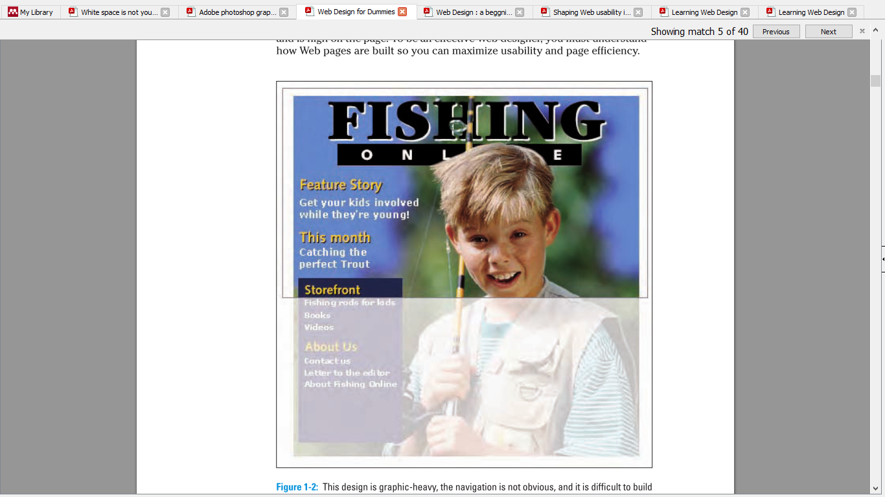
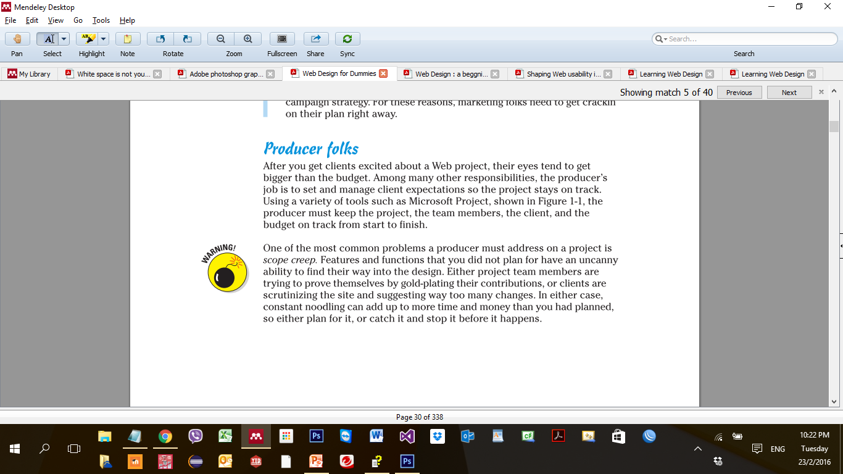
Understanding team member roles
Who of your team
can fix the error of this page?
Visual designers’ role

Slide 34
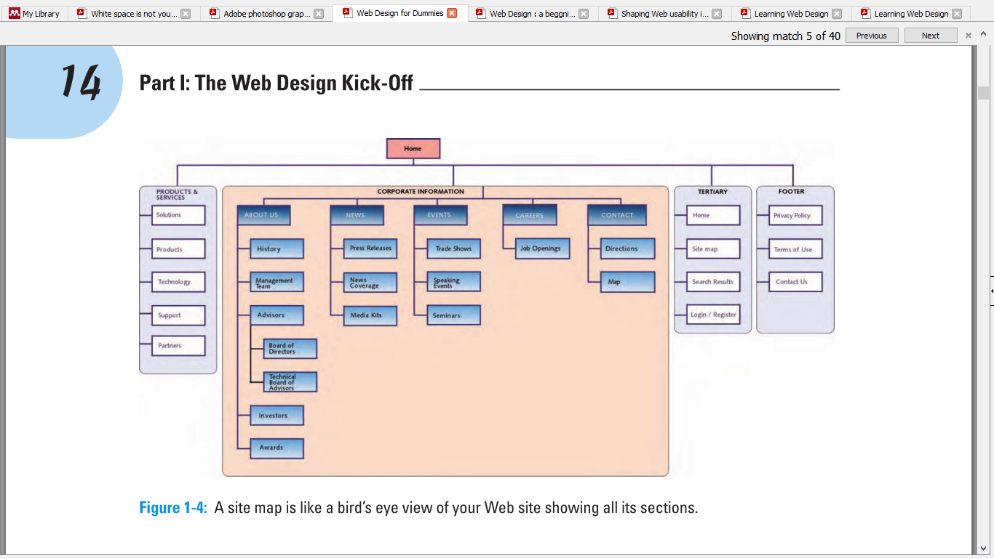
Understanding team member roles
Who of your team do the site map?
Information architects’ role

Slide 35
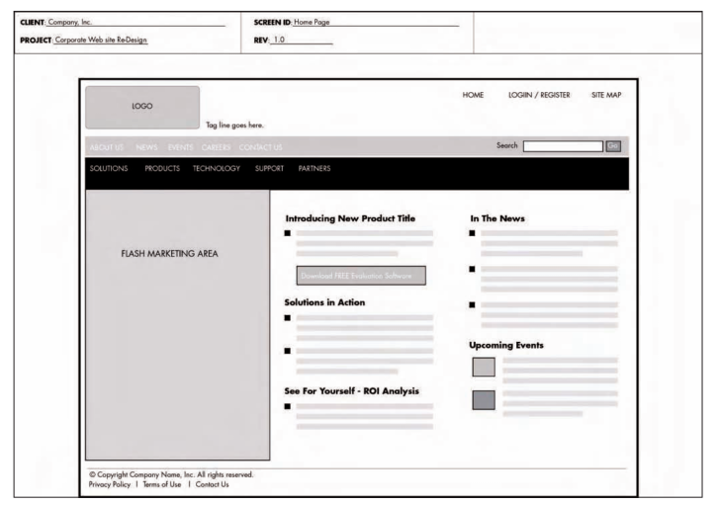
Understanding team member roles
Who of your team will do the wireframe?
Information architects’ role

Slide 36
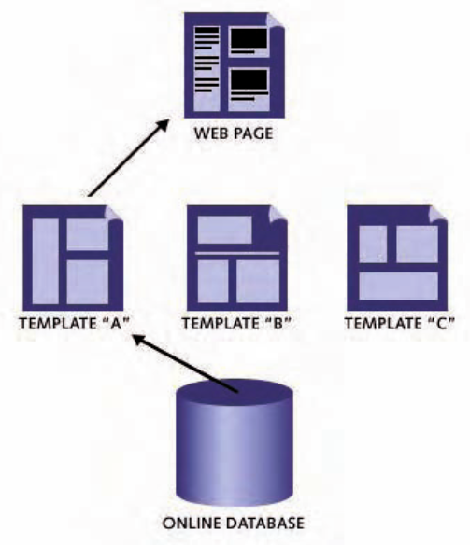
Understanding team member roles
Who of your team will create the online databases and deal with coding?
Programmers’ role

Slide 37
Thank you

